Slide 1
Clustering the Battery State of Health in Electric Vehicles
Nurdin Khoirurizka (諾丁) 312540025

Slide 2
Background
Rapid growth of electric vehicles (EVs)
Reduce our dependence on fossil fuels
Battery power sources are costly
Battery power required regular maintenance

Slide 3
Benefit
Predictive Maintenance
Optimized Charging Protocols
Enhanced Battery Management Systems
reduce financial losses due to battery replacement

Slide 4
Method
Agglomerative
K-Medoid
Hierarchical structure (allowing to visualize different levels of granularity in the data. This can provide insights into the hierarchy of battery health conditions, from broader categories to specific clusters) and flexibility in cluster shape (agglomerative clustering does not assume clusters to be spherical)
Robustness to outliers (this makes it suitable for data with noise or outliers, which is common in real-world battery datasets) and interpretability (the clusters are more interpretable and meaningful in the context of battery health analysis)
Mean Shift
Adaptive bandwidth (this method can automatically adapt the bandwidth parameter based on the density of data points. This makes it effective in identifying clusters of varying densities, can be beneficial in detecting different levels of battery degradation) and has no assumptions on cluster number
DBSCAN
noise handling (it will be effective in handling noise and outliers, which are common in battery datasets due to sensor inaccuracies or sporadic anomalies in battery behavior)

Slide 5
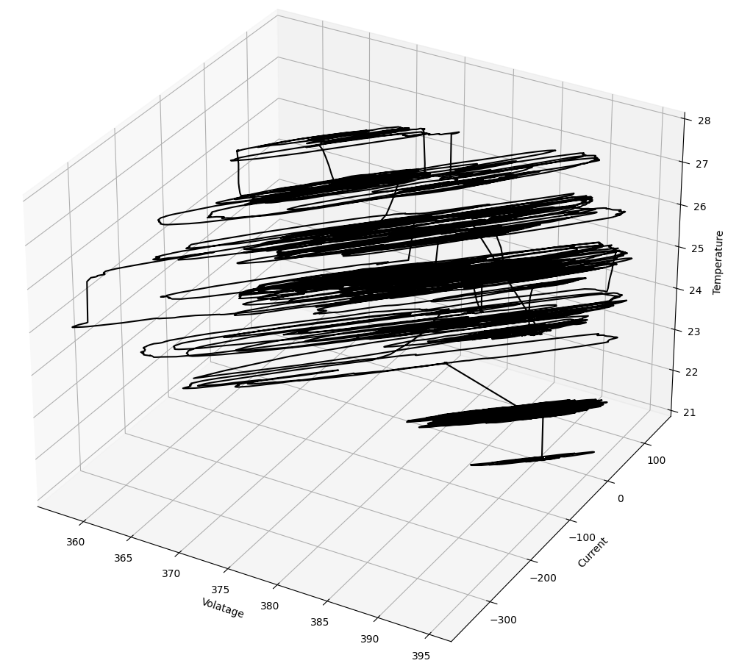
Battery Condition Dataset
 | Value
Total Dataset | 48,717

Slide 6
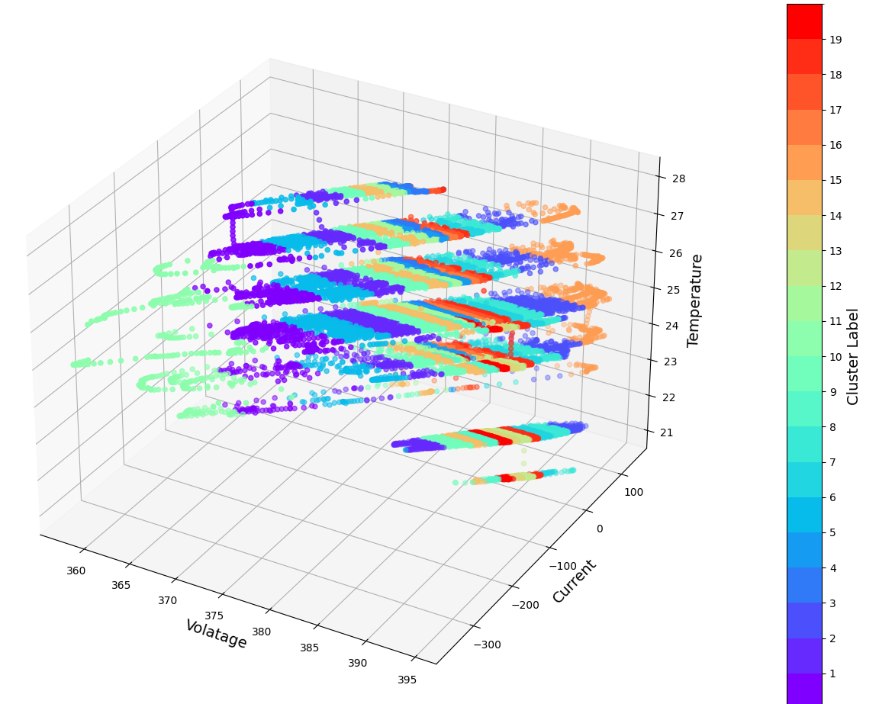
K-Medoid
Internal Evaluation | Value
Dunn Index | 1.058
Davies Bouldin Index | 0.7588
Xi-Beni Index | 0.0632
Silhouette Score | 0.4053

Slide 7
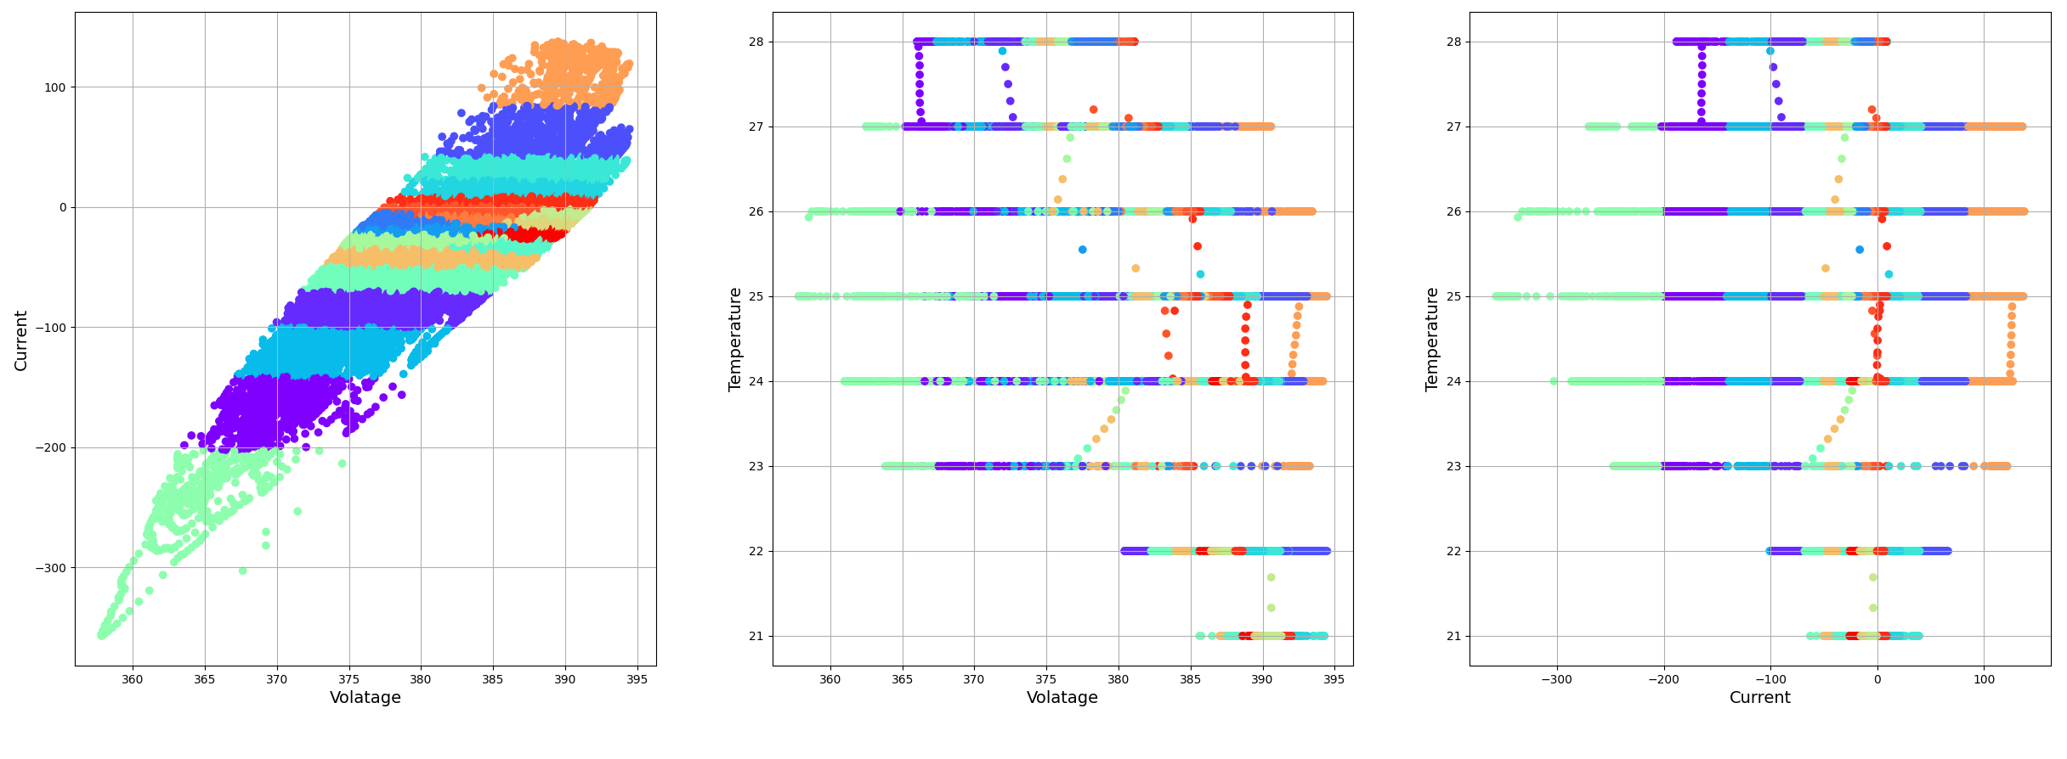
K-Medoid

Slide 8
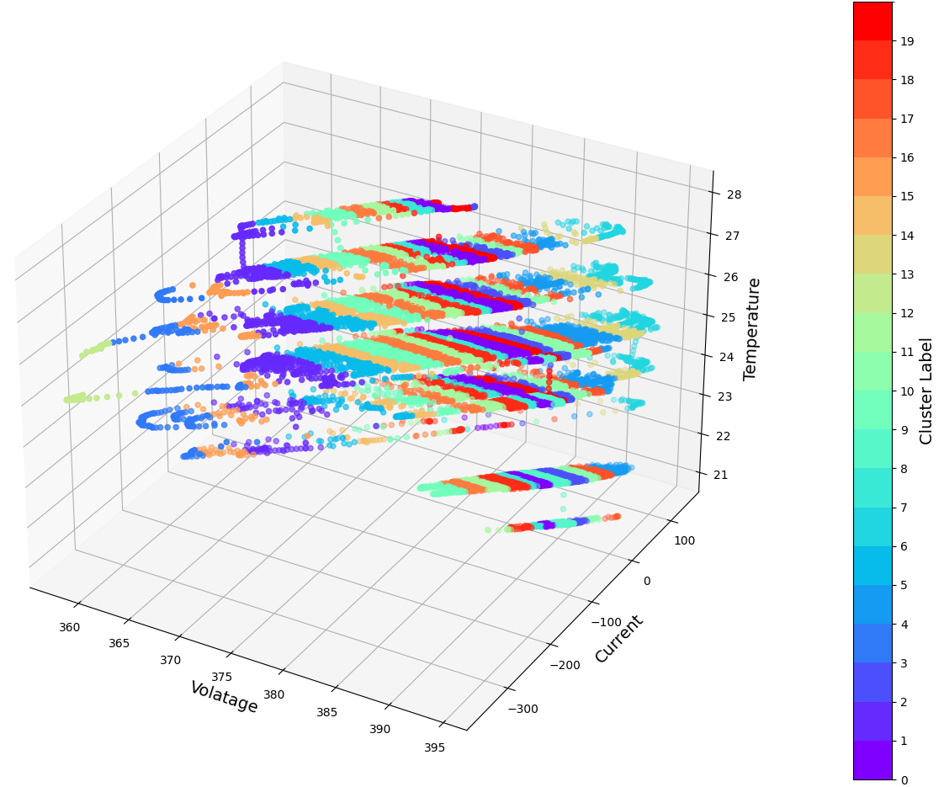
Agglomerative
Internal Evaluation | Value
Dunn Index | -
Davies Bouldin Index | 0.6985
Xi-Beni Index | -
Silhouette Score | 0.3484

Slide 9
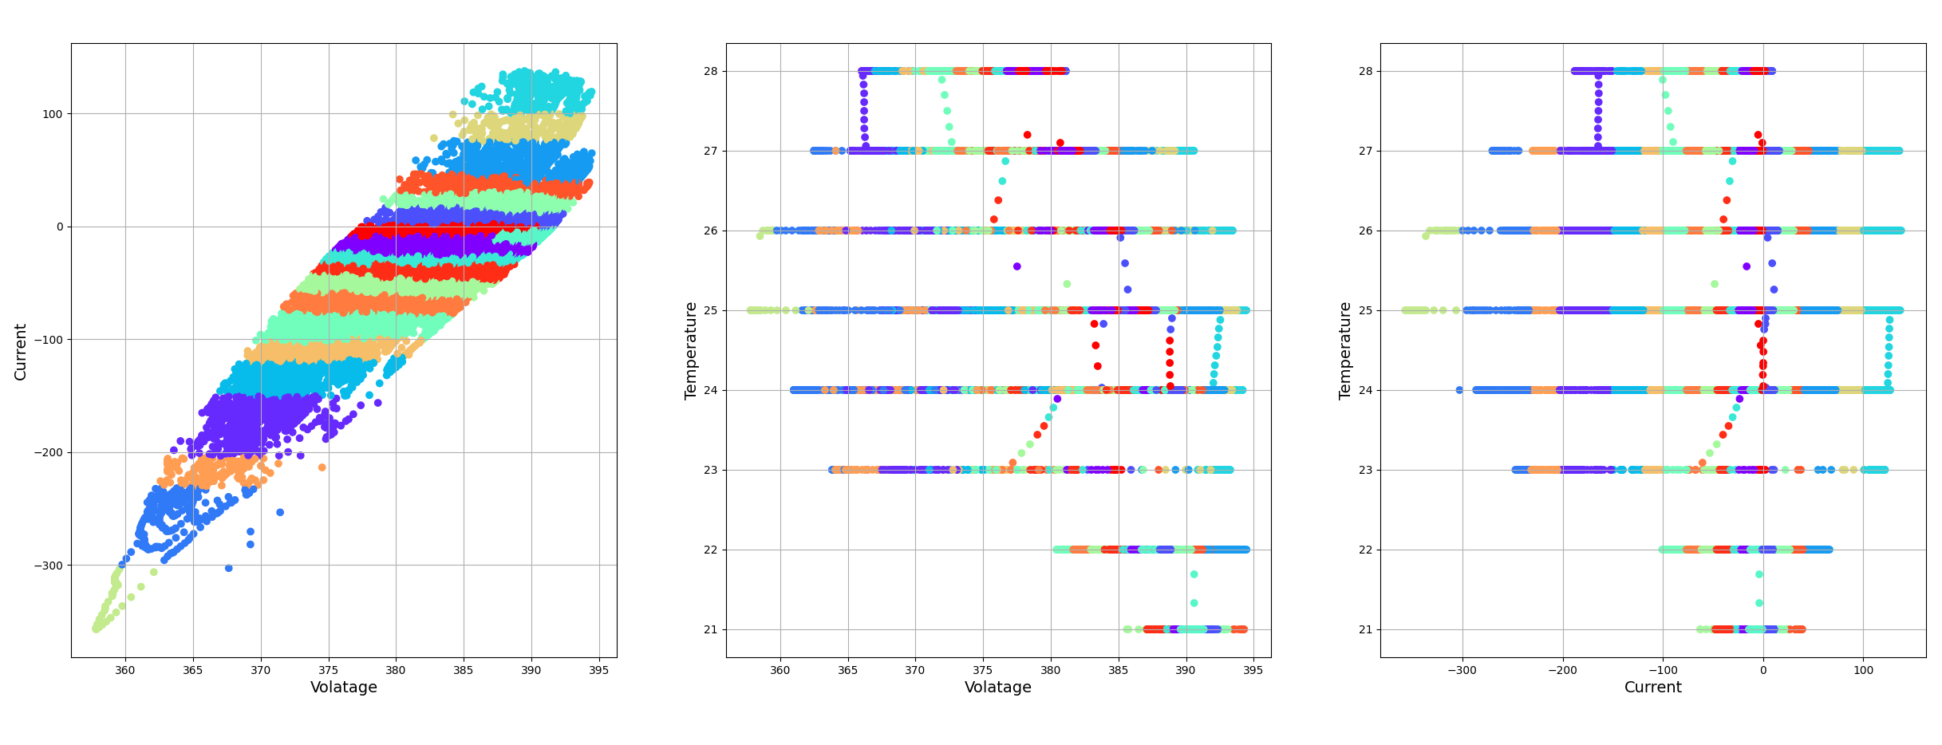
Agglomerative

Slide 10
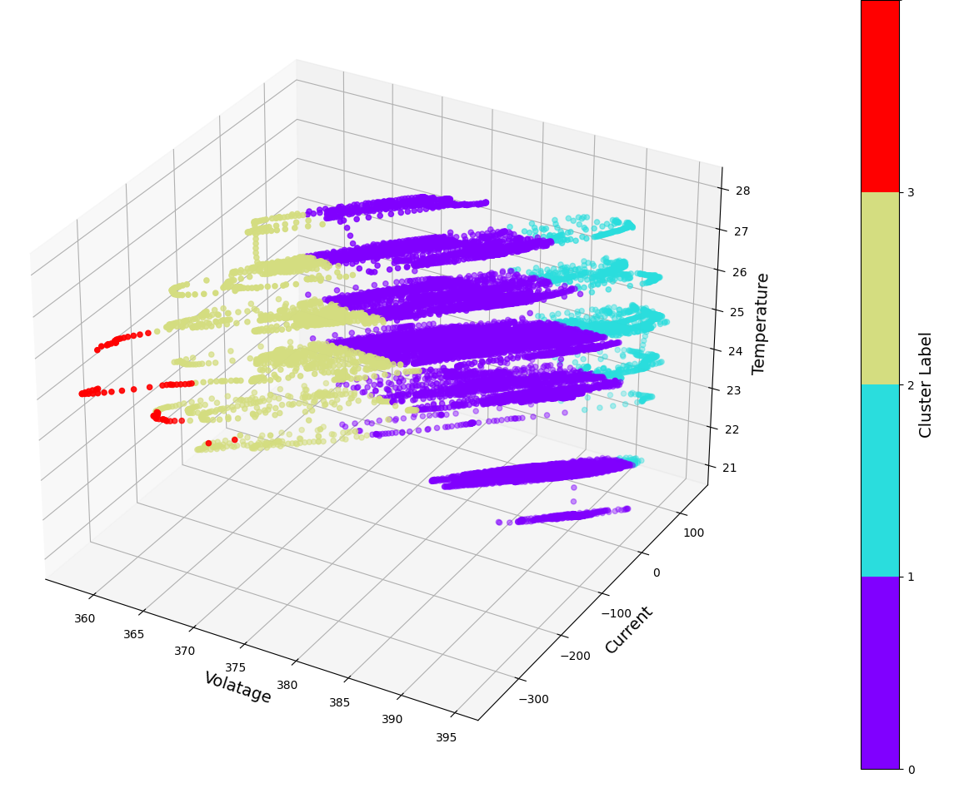
Mean Shift
Internal Evaluation | Value
Dunn Index | 0.2881
Davies Bouldin Index | 0.4195
Xi-Beni Index | 0.0991
Silhouette Score | 0.6340

Slide 11
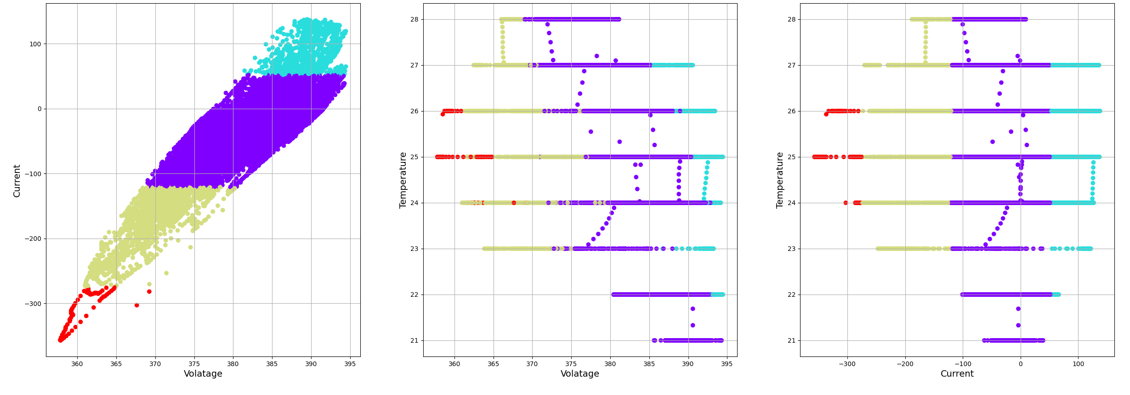
Mean Shift

Slide 12
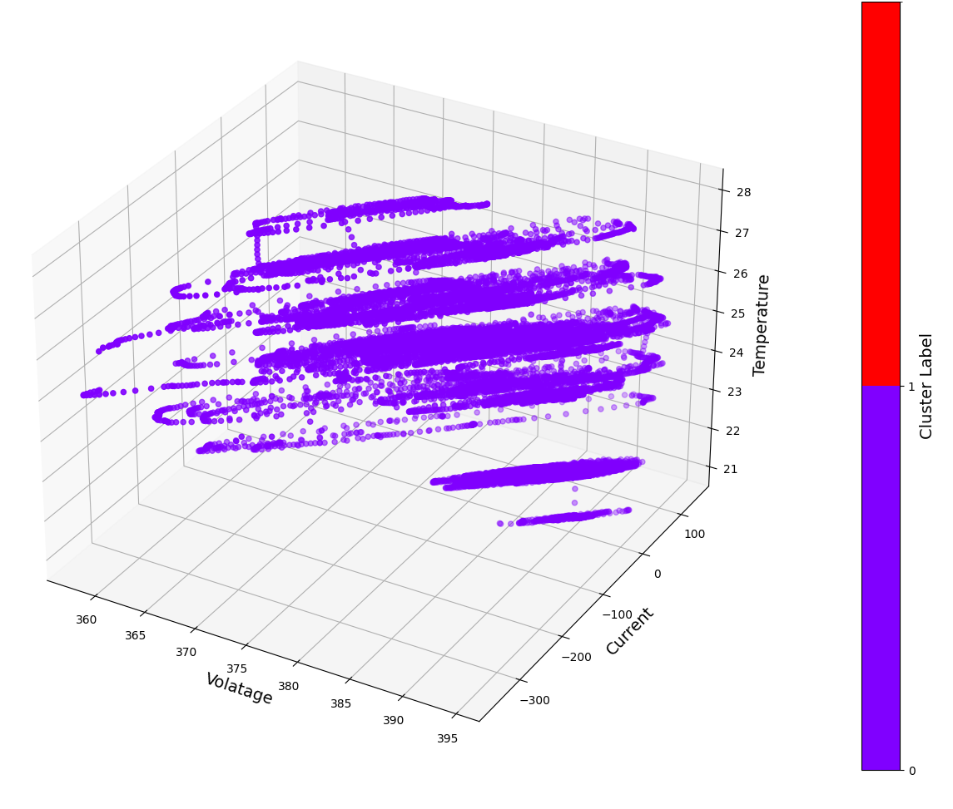
DBSCAN
Internal Evaluation | Value
Dunn Index | -
Davies Bouldin Index | 2.2532
Xi-Beni Index | -
Silhouette Score | 0.6291

Slide 13
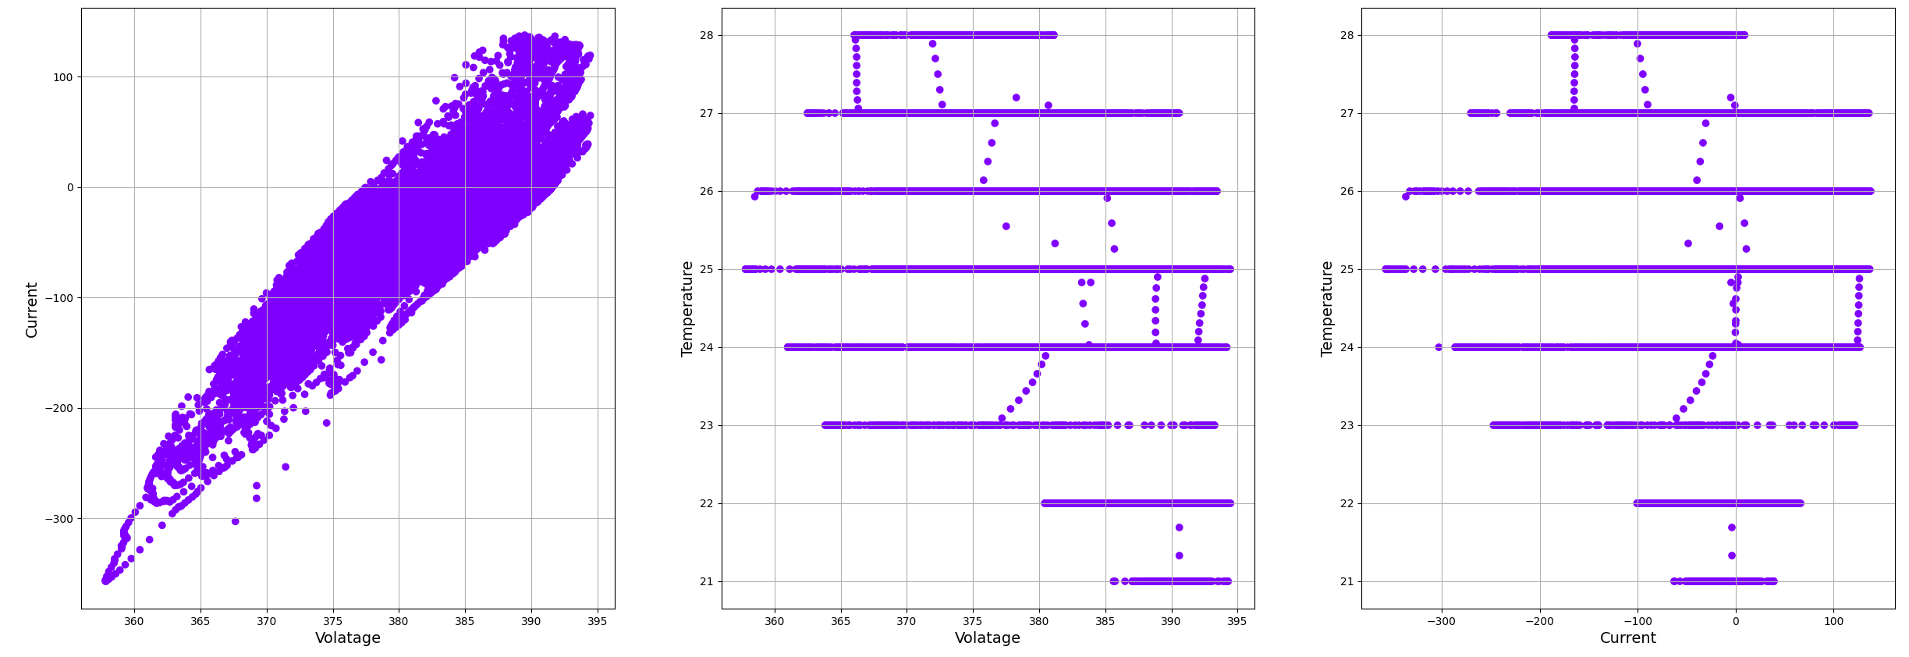
DBSCAN

Slide 14
Conclusion
Versatility of Clustering Methods
K-Medoid, Agglomerative, DBSCAN demonstrates their versatility and effectiveness in identifying distinct patterns
Identification of Distinct Battery States
This classification helps in understanding various operational states and predicting failures
Actionable Insights for Battery Management
The clustering results provide actionable insights that can be directly applied to improve battery management systems.
Challage to Real Implementation
Implementing clustering to accurately reflect the SoH of batteries is challenging due to the dynamic nature of battery environments

Slide 15
Thank you

